Slide 1
Caltrans Environmental Into The Future A Presentation for Lassen County Transportation Commission
Wesley Stroud
North Region Environmental Services
California Department of Transportation

Slide 2
Who am I?
Caltrans Supervising Environmental Planner, Redding/NR
Married with Two Children 10 and 8
Graduated with a BS in Environmental Science from Humboldt State University
Grew up in Red Bluff, CA
Biologist my entire life. Professionally started working at CDFW when I was 18 and have worked for the State ever since (Land Conservancy).
My passions are traveling, habitat restoration/Connectivity, hunting, fishing and spending time with family.

Slide 3
Today’s Topics
Wildlife Connectivity Projects
Caltrans CEQA and Permit Driven Mitigation (current and the dream)
Identification of Top 7 Wildlife Crossing Priorities (Caltrans District 2 Specific)
Identification of Top 13 deer crossing priorities (California Specific)
Notes:
Over 800 miles of anadromous fish habitat opened up by Caltrans District 2 our of Redding alone.

Slide 4
Caltrans California Environmental Quality Act and Permit Driven Mitigation (current and the dream)
What is it?
The Dream!
Collaborative Approach Regionally (Private/public partnerships)
Ecological Lift vs project by project view of mitigation
Out of Kind Mitigation
Investment in Connectivity

Slide 5
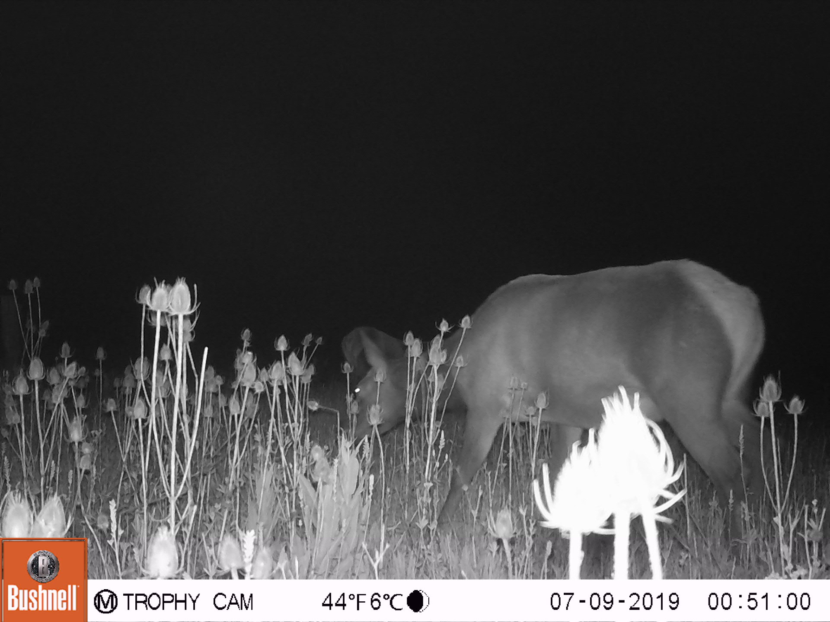
Ecological Lift vs Project by Project View of Mitigation
Notes:
New approach to Project Mitigation

Slide 6
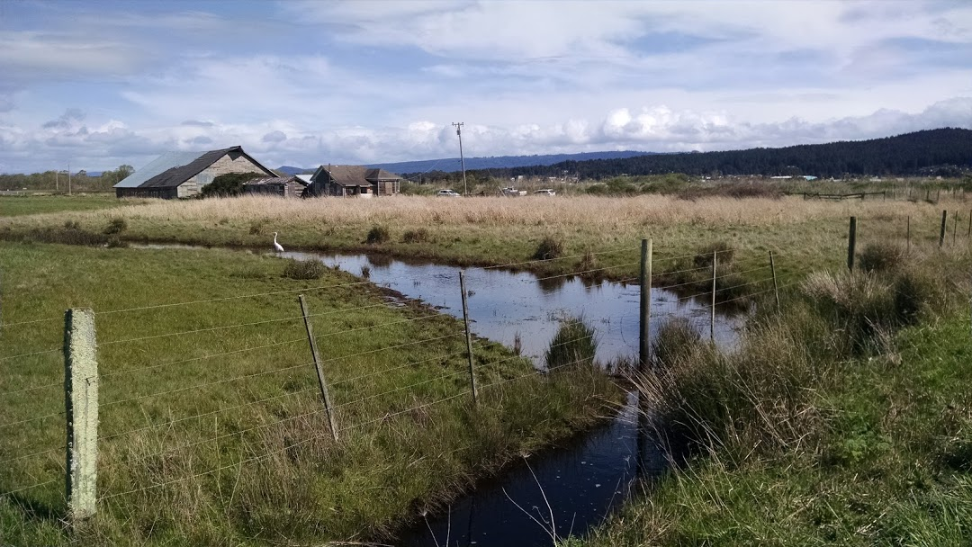
H-Bam (HUM-255-6.0/7.6)
H-Bam

Slide 7
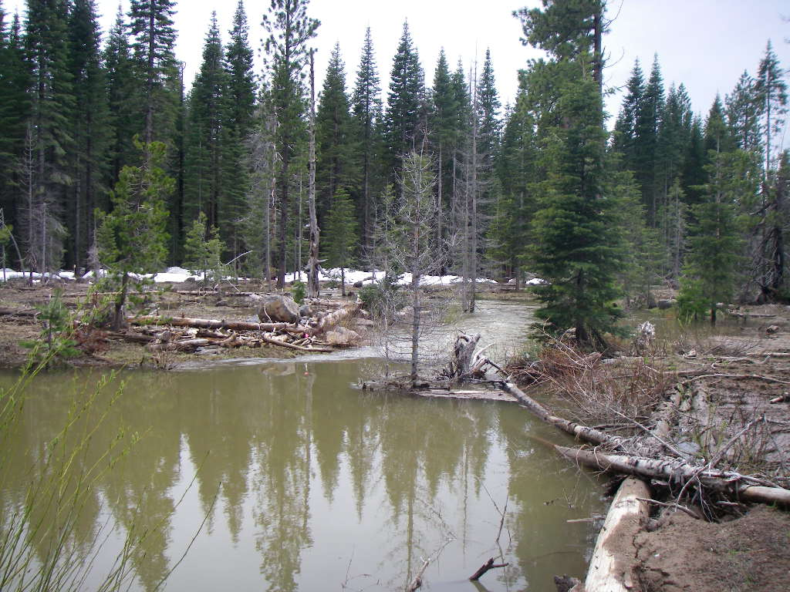
Other Mitigation Highlights
White Deer Lake Mit. Area
(mitigation site for Deadhorse Summit curve correction – Stevens Pass Road @ Trout Creek Campground/Shasta Trinity NF)
Trout Creek Mitigation Area
(mitigation site for Cayton Creek bridge replacement – Medicine Lake Road/Shasta Trinity NF)

Slide 8
Wildlife (Terrestrial) Crossings
What's Going on?
US 101 WCB/WTI Grant and Crossing Proposal
SR 89 D3 Work and Connectivity Team US 395 Bordertown Wildlife Fencing and Jumpouts
SR 139 Connectivity Team
US 97 WCB Grant and Crossing Proposal

Slide 9
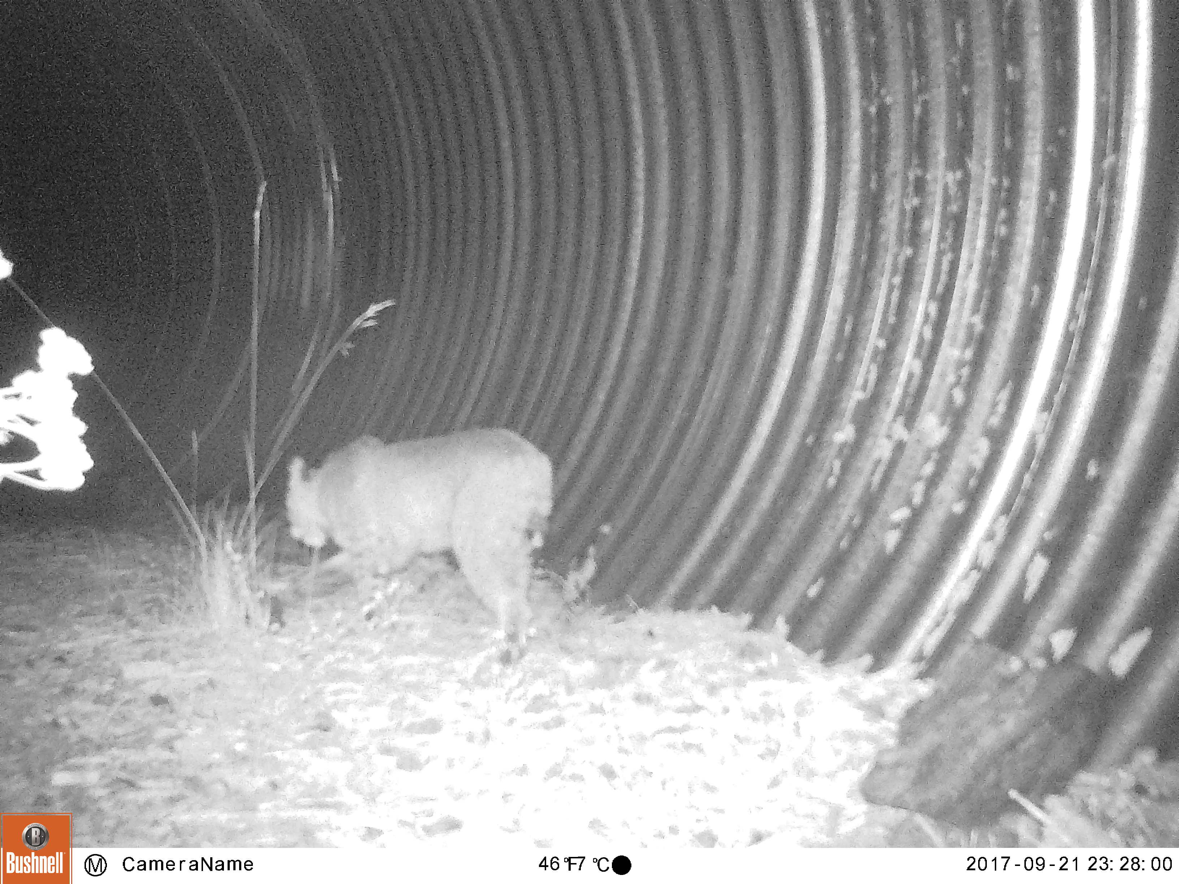
Wildlife Crossing Update
Successful projects to date
Trail Gulch (SHA-299-PM 4.0)
Water Gulch (SHA-299-PM 4.0)
Benefit-to-cost ratio
Trail Gulch–black bear
Water Gulch–bobcat

Slide 10
Top 13 Deer Crossing Priorities Statewide

Slide 11
Top 7 Wildlife Crossing Priorities in District 2

Slide 12
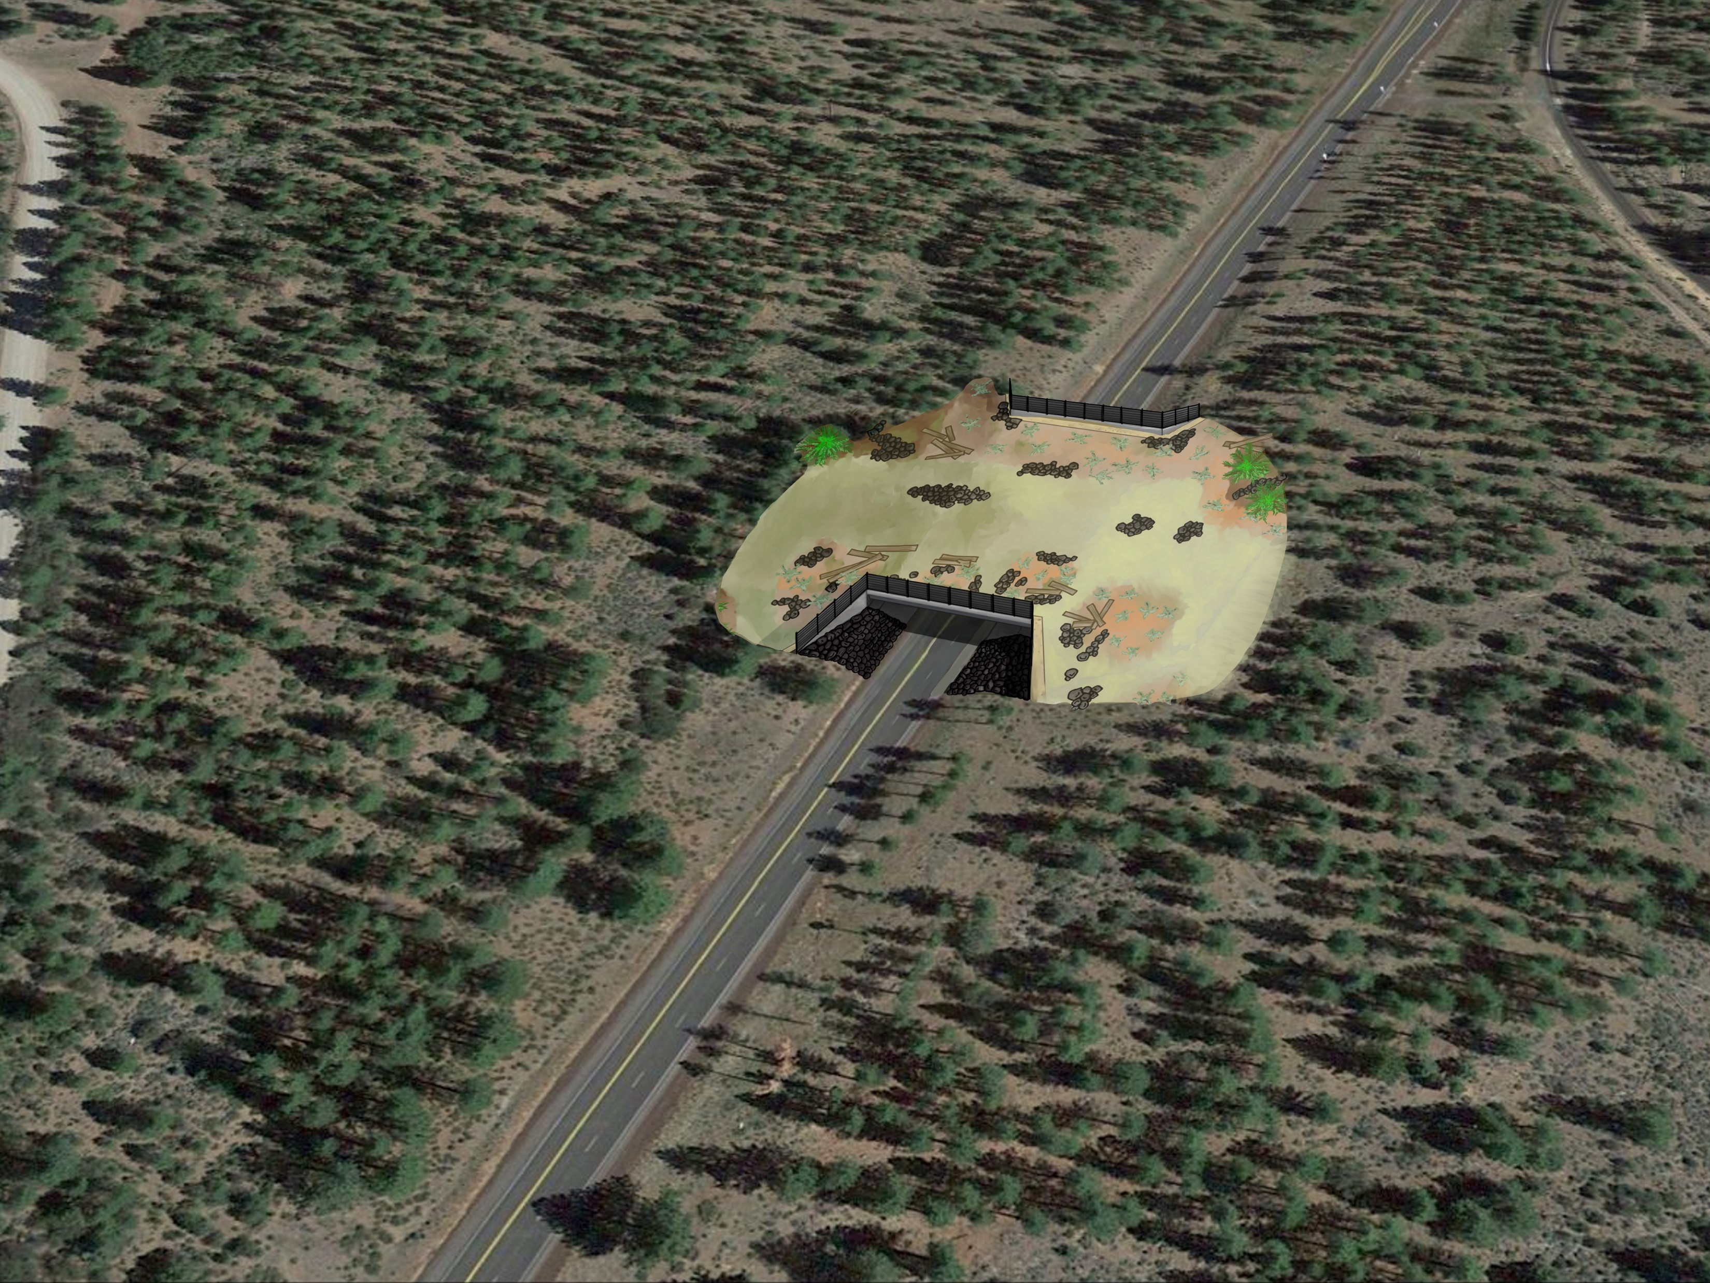
U.S. 97 Wildlife Conservation Board and Western Transportation Institute Grants and Wildlife Crossing Proposal (SIS-97-PM 20.0/40.0)

Slide 13
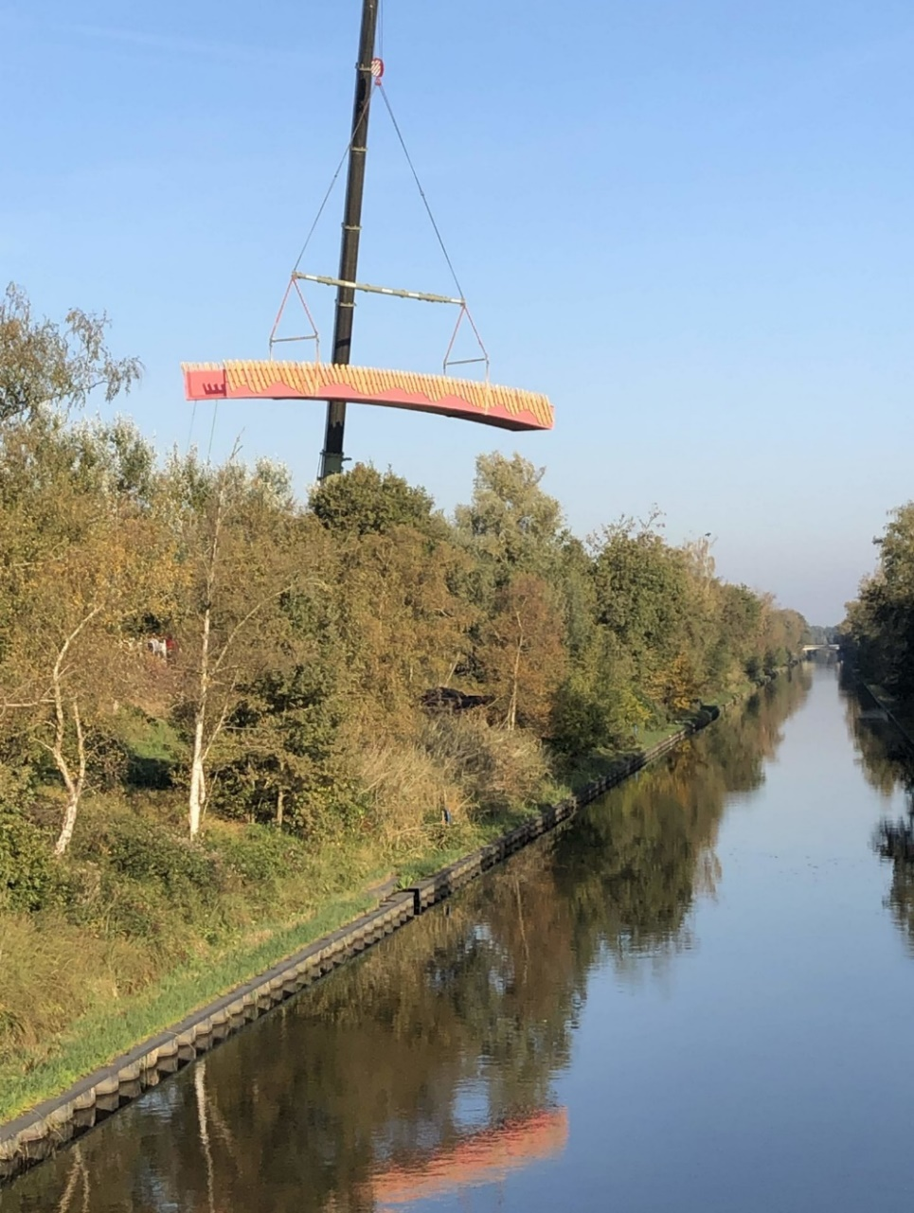
Fiber Reinforced Polymer
Fiber-reinforced polymers (FRPs) are a composite material of structural fibers set in a mold of thermoset resin. The resins do not get soft at elevated temperatures so they restrain the fibers against buckling and allow the transfer of shear stress between them.

Slide 14
Benefits of FRP Structures
High strength to weight ratio.
Light weight material reduces transportation and construction costs.
Service life of 100 years.
Little/no maintenance required.
Extremely resistant to corrosion and rot.
Does not absorb water.
Depending on the type of resin and fibers selected, FRP materials can be:
Fire, ultra-violet ray and impact resistant.
Electromagnetically transparent.
Have low thermal conductivity.
Provide no electrical conductivity.
Bio-based or use recycled plastic.

Slide 15
Video

